Slide 1
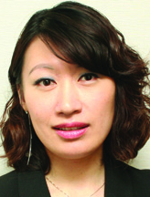
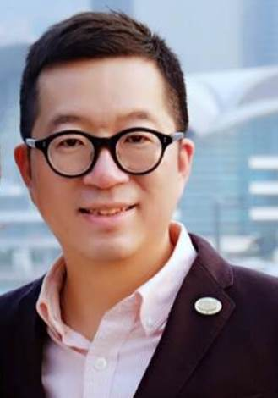
利用TLS達成事業目標
Reach Your Goals With TLS
Emmy Yeung
Calvin Ip
高級顧問經理級
Director
四個佣金週期共賺取HK$138,000
HK$138,000 in 4 Commission weeks
產品拓展經理
Product Marketing Manager
本簡報中提到的收入等級純屬舉例說明，無意代表美安香港超連鎖™店主的一般收入，也無意表示任何超連鎖™店主皆可賺取同等收入。美安香港超連鎖™店主的成功與否，取決於其在發展事業時的努力、才能與投入程度。
The income levels mentioned in the following presentation are for illustration purposes only. They are not intended to represent the income of a typical Market Hong Kong UnFranchise ™Owner, nor are they intended to represent that any given Independent UnFranchise ™ Owner will earn income in that amount. The success of any Market Hong Kong Independent UnFranchise ™ Owner will depend upon the amount of hard work, talent, and dedication which he or she devotes to building his or her Market Hong Kong Business.

Slide 2
Weight loss isn’t magic...it’s just science.

Slide 3
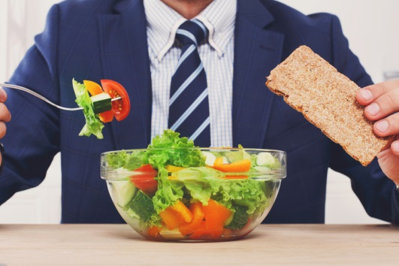
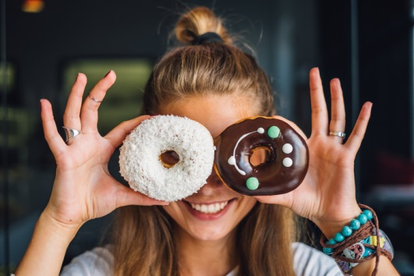
The Weight Loss OPPORTUNITY
38.8% of HK population aged 18-64 are >23 BMI, including 20.7% are obese*
A higher proportion of males (48.2%) than females (30.5%) were classified as overweight or obese. People aged 55-64 had a highest rate (49.4%) of overweight or obesity*
Underserved Weight Loss Markets
Adult Men
Teen Market
Metabolic Syndrome Market
Worksite-based Markets
*Centre for Health Protection. DOH. https://www.chp.gov.hk/en/healthtopics/content/25/8802.html

Slide 4
Lifestyle is health...
proven to prevent and often times reverse obesity-related chronic disease* using non-drug modalities
*Lifestylemedicine.org; American College of Lifestyle Medicine

Slide 5
Lifestyle is health...
Diet and Nutrition
Physical Activity
Sleep
Emotional Wellness
Community
Relationship
Alcohol and Tobacco Cessation

Slide 6
Weight Management; A Fiscal Responsibility
Current health care costs for diabetes amount to
around $2 billion HKD per year, about half of which are related to overweight and obesity among adults.
SM McGhee *, GN Thomas, CM Schooling, J Chau, LC Wong. Economic burden of diabetes related to excess body weight in Hong Kong. Hong Kong Med J 2014;20(Suppl 3):S5-7

Slide 7
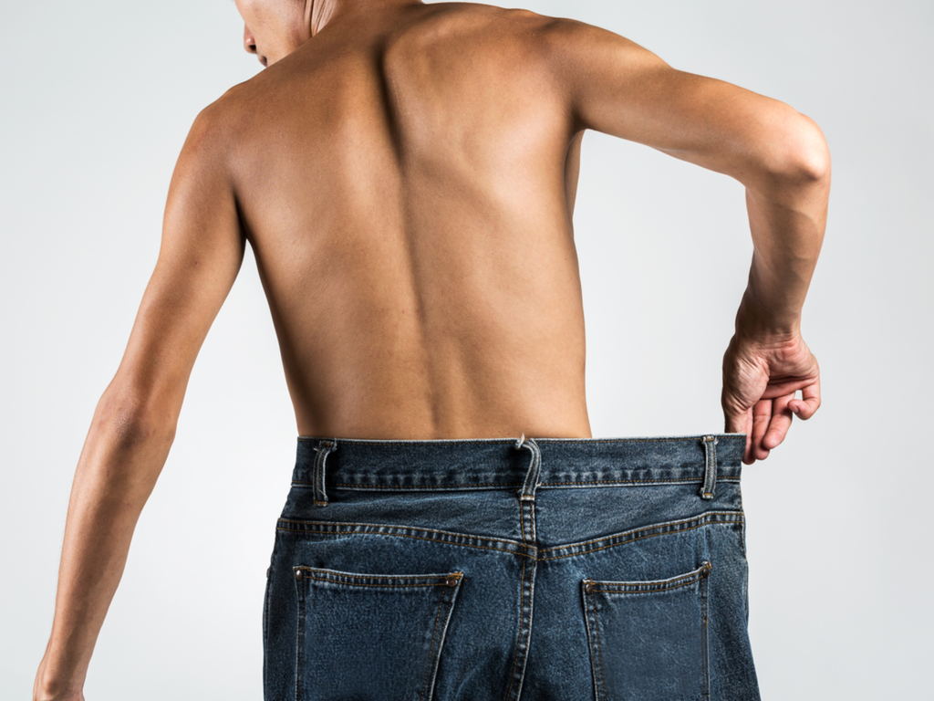
A proven comprehensive, customizable, backed by science program focused on a lifestyle approach.

Slide 8
The 4 Components of TLS®...
Low-glycemic Impact Eating
Supple-mentation
Body Composition
Education

Slide 9
Quick TLS® Supplement Fact
Why Supplements...
Designed to support a new healthy lifestyle
Poor Dietary Habits
Support Hormone Balance
Carbohydrate Sensitivity
Chronic Stress and Fatigue
Metabolism Support
Burn Fat

Slide 10
D

Slide 11
Code: HK6610 UC: HK$243.00 SR: HK$341.00 BV: 20

Slide 12
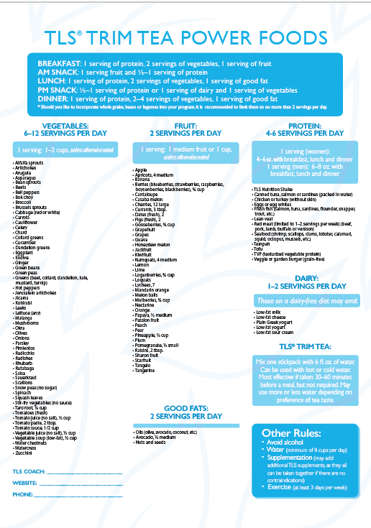
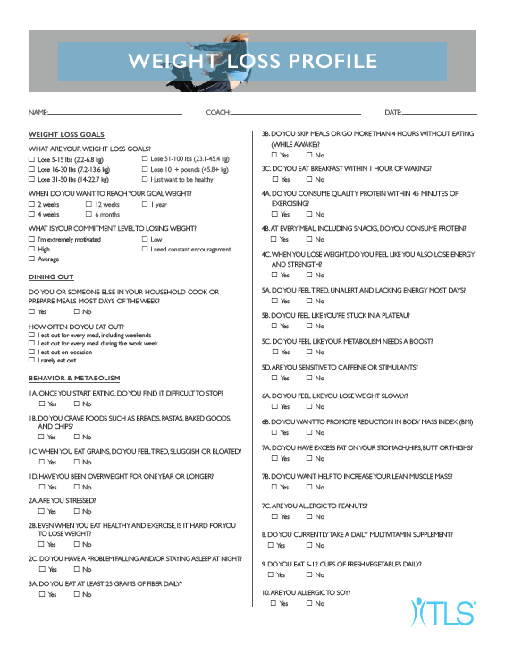

Slide 13
Options are the Key
TLS® 12-Week Program
TLS® 21-Day Challenge

Slide 14
2017 TLS Top 21 SALES WINNERS
ROBERTS, LEE & CARIN | USA
NGUYEN, LANIE AND VAN | USA
VISCOME, JESSICA & JOSEPH | USA
CHUN-YI, CHEN | TWN
FREEMAN, LIBERTY P | USA
PATRICK, SUZANNE | USA
PENG, QIANRUI | USA
SHU-FENG, TSENG | TWN
XU, CHENGCHENG | USA
WANG, NANCY & TINGCHUNG | USA
CORMACK, MEGAN AND ADAM | USA
VACCA, NANCY R | USA
MILLER-IHLI, NANCY J & KEVIN D | USA
HUANG, HANTING | USA
SELICK, CARYN E & BLOOMGARDEN, AMY (MDs) | USA
HOSODA, SADATO | USA
ORSHAN, JOANNE | USA
MICHAUD, JESSICA | USA
HSIAO-CHEN, HUANG | TWN
GERSHMAN, JENIFER LYN | USA
DENNIS, APRIL & PARKER, KAM | USA

Slide 15
2018 – TLS ® TOP 21 GLOBAL SALES PROMOTION
FOR:
Australia, Canada, Hong Kong, Malaysia, Mexico, Singapore, Spain, Taiwan, United Kingdom, USA
Must be a qualified and active Unfranchise Owner
Promotion will run February 1, 2018 to June 30, 2018
Points will be awarded each USD $1 (UFO Cost) or Preferred Customer sales of TLS coded, branded products
500 points will be awarded for a new personally sponsored and qualified business partner who majors in TLS
Winners selected by July 31, 2018

Slide 16
Build Your Business
Through
Transitions Lifestyle System

Slide 17
Retailing For Base 10
Everyone Knows Someone
Get Social
Gather Your Favorite Tools
Book a TLS® Overview
Sell a TLS® Solution
Based on goals, commitment, affordability
Follow Up

Slide 18
1) Social Media: Open Up New Market
Create a Strategy
Use a Call-to-Action
Love the TLS® Lifestyle
Solve a Problem
Be Social!
Post Captivating Visuals
Notes:
Strategy
Don’t go in without a plan
Voice:
How will you portray yourself + your brand to stand out?
Professional? Motivational? Funny? Empowered?
How can you make an interaction seem friendly and causal. People are much more likely to chat about personal goals in a private-feeling setting.
Choose Your Content:
How do you want to be perceived?
How will your content, captions, interactions with followers reinforce that?
80/20:
80% genuine social presence (i.e. Living the TLS Lifestyle), 20% product push
People want to connect, not see ads – so be personable + don’t overwhelm them with “BUY NOW”
Find + Target Your Audience
What audience are you trying to reach?
What do they like to see?
How can you reach and connect with them?
CTA
Encourage reviews, purchasing, site visits, or engagement
Examples:
Send us a message to learn more!
Hurry + stock up today!
Tell us which of these is your favorite in the comments!
Leave a review + tell us what you love
Love the TLS Lifestyle
Be EXCITED!
Show your excitement, passion, and enthusiasm about TLS and others will want to do it, too!
Post images, videos, recipes, workouts, motivation
High-quality images
Wear the TLS gear.
Photograph yourself “being” TLS share on social media
Make yourself and your goals more relatable to your audience.

Slide 19
Connect With Us!
@TLSmhk
TLS Hashtags:
#hktls
#TLS21days
#FindYourFit
S

Slide 20
TLS® Orientation and Education
HK.tlsSlim.com/your url
TLS Audios
TLS 101
TLS 201
Download TLS Coaching Guide
Download TLS Business Guide

Slide 21
2) Customers / UnFranchise™ Owners become GoNow Partners
Notes:
Strategy
Don’t go in without a plan
Voice:
How will you portray yourself + your brand to stand out?
Professional? Motivational? Funny? Empowered?
How can you make an interaction seem friendly and causal. People are much more likely to chat about personal goals in a private-feeling setting.
Choose Your Content:
How do you want to be perceived?
How will your content, captions, interactions with followers reinforce that?
80/20:
80% genuine social presence (i.e. Living the TLS Lifestyle), 20% product push
People want to connect, not see ads – so be personable + don’t overwhelm them with “BUY NOW”
Find + Target Your Audience
What audience are you trying to reach?
What do they like to see?
How can you reach and connect with them?
CTA
Encourage reviews, purchasing, site visits, or engagement
Examples:
Send us a message to learn more!
Hurry + stock up today!
Tell us which of these is your favorite in the comments!
Leave a review + tell us what you love
Love the TLS Lifestyle
Be EXCITED!
Show your excitement, passion, and enthusiasm about TLS and others will want to do it, too!
Post images, videos, recipes, workouts, motivation
High-quality images
Wear the TLS gear.
Photograph yourself “being” TLS share on social media
Make yourself and your goals more relatable to your audience.

Slide 22
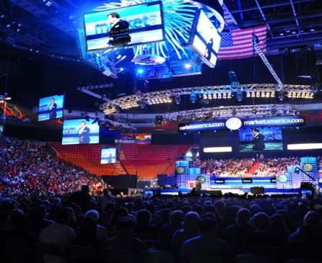
Building Your TLS Business with TLS®
RETAILING
SPONSORING
EDUCATION
SHOPPING ANNUITY
Everything you need to do to earn ongoing income!

Slide 23
Weight loss isn’t magic...it’s just science.

